Slide 1
INFO 215:
Social Aspects of Information Systems
Week 3B – Just Plain Creepy?

Slide 2
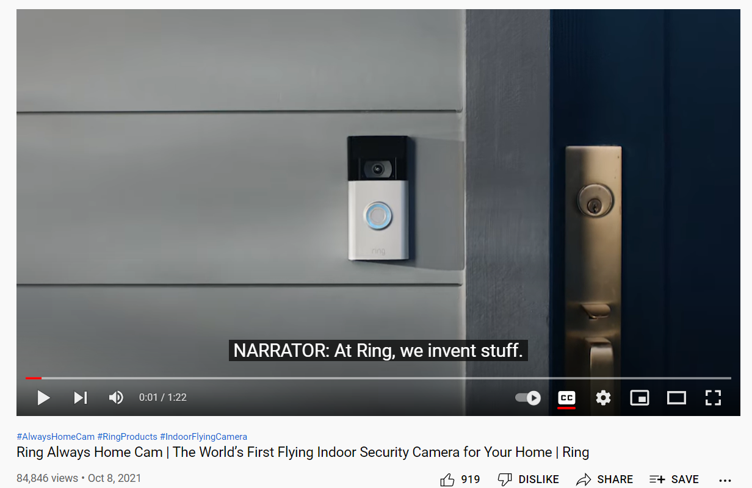
Discussion of readings
Bridges, 2021, Amazon’s Ring is the largest civilian surveillance network the US has ever seen
Harwell, 2020, Ring and Nest helped normalize American surveillance and turned us into a nation of voyeurs
What’s next, now that Ring
and Nest are no longer the
new thing?

Slide 3
Discussion of readings
Bridges, 2021, Amazon’s Ring is the largest civilian surveillance network the US has ever seen
Harwell, 2020, Ring and Nest helped normalize American surveillance and turned us into a nation of voyeurs
If money were not an issue, would you purchase one of these systems? Why or why not?

Slide 4
Discussion of readings
Bridges, 2021, Amazon’s Ring is the largest civilian surveillance network the US has ever seen
Harwell, 2020, Ring and Nest helped normalize American surveillance and turned us into a nation of voyeurs
If money were not an issue, would you purchase one of these systems? Why or why not?
What do you think about the authors’ ideas of Ring and Nest as civilian surveillance systems?

Slide 5
Discussion of readings
Bridges, 2021, Amazon’s Ring is the largest civilian surveillance network the US has ever seen
Harwell, 2020, Ring and Nest helped normalize American surveillance and turned us into a nation of voyeurs
If money were not an issue, would you purchase one of these systems? Why or why not?
What do you think about the authors’ ideas of Ring and Nest as civilian surveillance systems?
Why might these systems lead to increased bias in community policing?

Slide 6
Discussion of readings
Bridges, 2021, Amazon’s Ring is the largest civilian surveillance network the US has ever seen
Harwell, 2020, Ring and Nest helped normalize American surveillance and turned us into a nation of voyeurs
If money were not an issue, would you purchase one of these systems? Why or why not?
What do you think about the authors’ ideas of Ring and Nest as civilian surveillance systems?
Why might these systems lead to increased bias in community policing?
Should law enforcement agencies be allowed to use user-collected data?

Slide 7
Discussion of readings
Bridges, 2021, Amazon’s Ring is the largest civilian surveillance network the US has ever seen
Harwell, 2020, Ring and Nest helped normalize American surveillance and turned us into a nation of voyeurs
If money were not an issue, would you purchase one of these systems? Why or why not?
What do you think about the authors’ ideas of Ring and Nest as civilian surveillance systems?
Why might these systems lead to increased bias in community policing?
Should law enforcement agencies be allowed to use user-collected data?
Consider the first question again: If money were not an issue, would you purchase one of these systems? Why or why not?

Slide 8
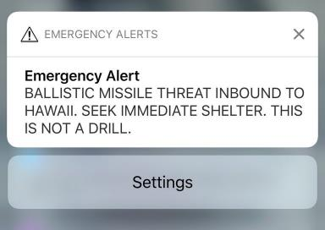
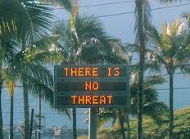
What was the Hawaii false alarm crisis, and how can the sociotechnical approach help us understand what happened?
January 13, 2018: ballistic missile alert issued via the Emergency Alert System over TV, radio, & cellphones across Hawaii.
Civil defense outdoor warning sirens rang out; many people panicked
Alert rescinded 38 minutes later – officials blamed the error on Hawaii Emergency Management Agency miscommunications

Slide 9
Small group discussion
Discuss Robertson’s “Human-Centered Design and the Missile False Alarm in Hawaii.” (https://tinyurl.com/y96ooadh)
Choose a discussion moderator and someone to report to class. Discuss:
Why did the drill go so wrong and cause so much unnecessary panic? List as many reasons as you can.
Divide your list of reasons into two categories:
  technical causes of the panic (system-based causes)
  Example: There was no automatic cancel feature. Manually cancelling the alert took more than 30 minutes, during which time panic grew.
  social causes of the panic (people-based causes)
  Example: Due to increased tensions between North Korea and the U.S., Hawaii was on heightened security alert.

Slide 10
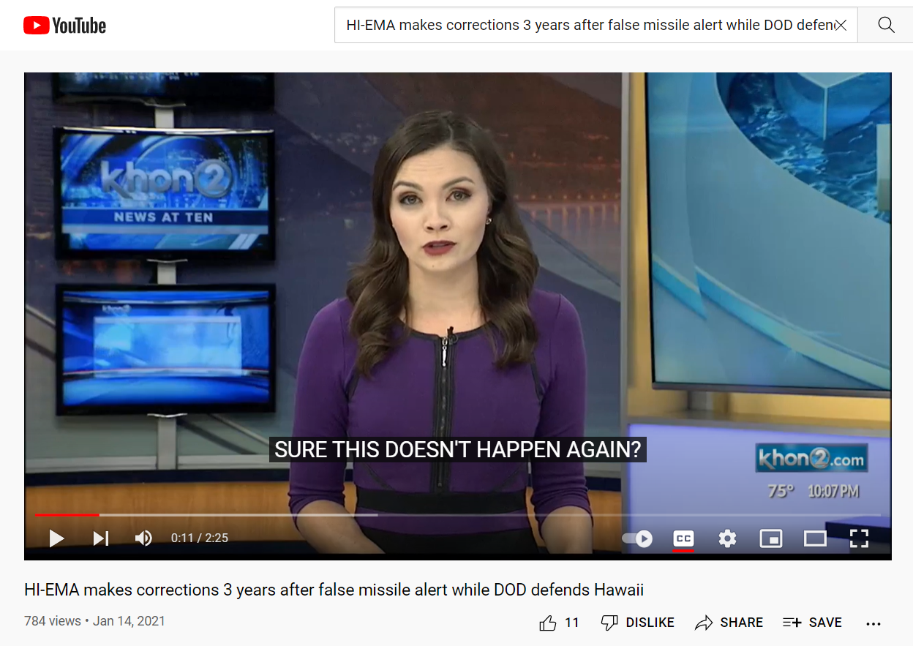
https://www.youtube.com/watch?v=2h5407HD6YY

